Slide 1
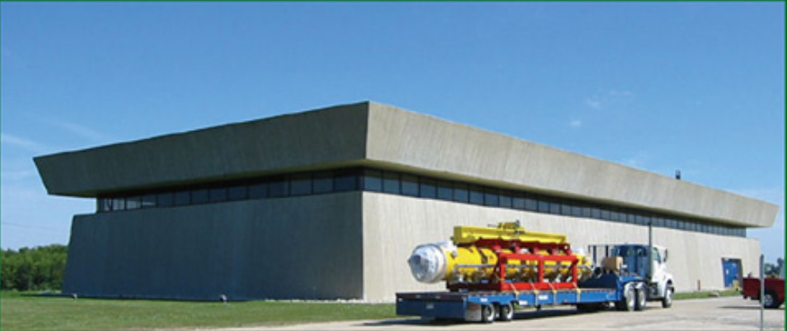
Fermilab Accelerator Science and Technology (FAST) Facility
Eric Prebys
Accelerator Physics Center
Fermilab

Slide 2
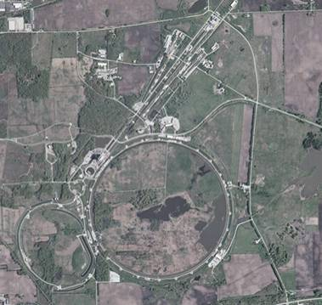
A Brief History of Fermilab (evolving slide)
1968: construction begins
1972: first beams
200➔400 GeV proton beams
Highest energy lab ever since
~1985:
“Tevatron”: first superconducting synchrotron.
900GeV x 900 GeV p-pBar collisions
Upgraded in 1997
Main Injector-> more intensity
980 GeV x 980 GeV p-pBar collisions
Intense neutrino program
Soon the second most powerful collider
Fermilab is now the only remaining US High Energy Physics Lab
With the LHC now the highest energy collider, the lab must focus on different types of physics.
until recently
For awhile

Slide 3
Fermilab Firsts and Records
Firsts:
First separated function synchrotron:
Main Ring, 1972
First superconducting synchrotron/collider
Tevatron, 1983 (first collisions in 1986)
First permanent magnet storage ring
Recycler, 2000
Records:
Highest energy proton beam
Main Ring, 1972 (breaks AGS record)➔1983 (broken by Tevatron)
Tevatron, 1983-2008 (broken by LHC)
Highest energy hadron collider
Tevatron, 1986 (breaks SppS record)➔2009 (broken by LHC)
Highest hadronic luminosity
Tevatron, 2005 (broke ISR *p-p* record!) ➔ 2011 (broken by LHC)
Highest energy p-pbar collider
Tevatron, 1986 (breaks SppS record)➔ present
Highest p-pbar luminosity
Tevatron, 1992 (broke SppS record)➔ present

Slide 4
P5 Report
The Particle Physics Project Prioritization Panel (P5) advises the DOE Office of High Energy Physics on research funding priorities in high energy physics
After a lengthy process, the panel released a report in May, 2014. Top priorities for Fermilab:
Support the LHC and its planned luminosity upgrades
Pursue the g-2 and Mu2e muon programs*
Focus on a high energy neutrino program to determine the mass hierarchy and measure CP violation.
“Flagship” activity
Will ultimately require a “multi-megawatt” beam at 60-120 GeV
Continue at least R&D toward a future linear e⁺e⁻ collider (ILC)
FAST supports these
*see my colloquium this afternoon

Slide 5
ILC-Related R&D
This is the easy one…
Over the last ~15 years, Fermilab has gone from having no SRF program to becoming one of the world leaders.
Fermilab areas of interest include
Increasing gradient and high-gradient-Q of cavities
Source/LEBT/RFQ/MEBT development
Bunch manipulation
Systems and integration issues.
This work is largely orthogonal to the rest of the Fermilab program
Understanding the rest of the program requires some understanding of the lab’s long term plans…
FAST program

Slide 6
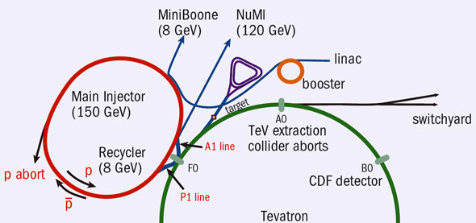
Current Fermilab Accelerator Complex
Following the LHC turn-on, FNAL has transitioned to an intensity based program
The 8 GeV source is the chief limit to intensities
Accumulator/Debuncher: Formerly for pBar accumulation, soon muon and proton manipulation for g-2 and Mu2e
Neutrinos
Recycler: Formerly for pBar storage, now for proton pre-stacking for NOvA
LBNF
(120 GeV)
~45 years old!
/400 MeV
/8 GeV
120 GeV+secondaries

Slide 7
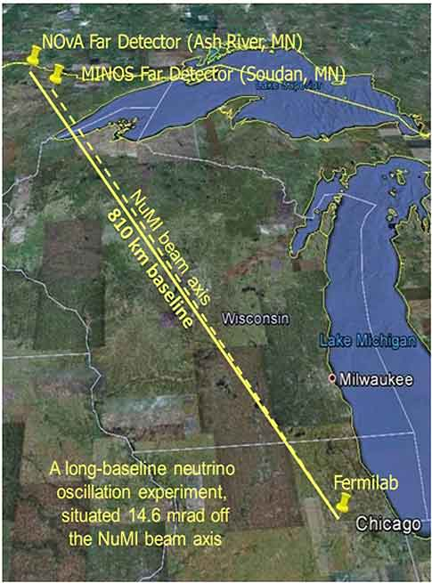
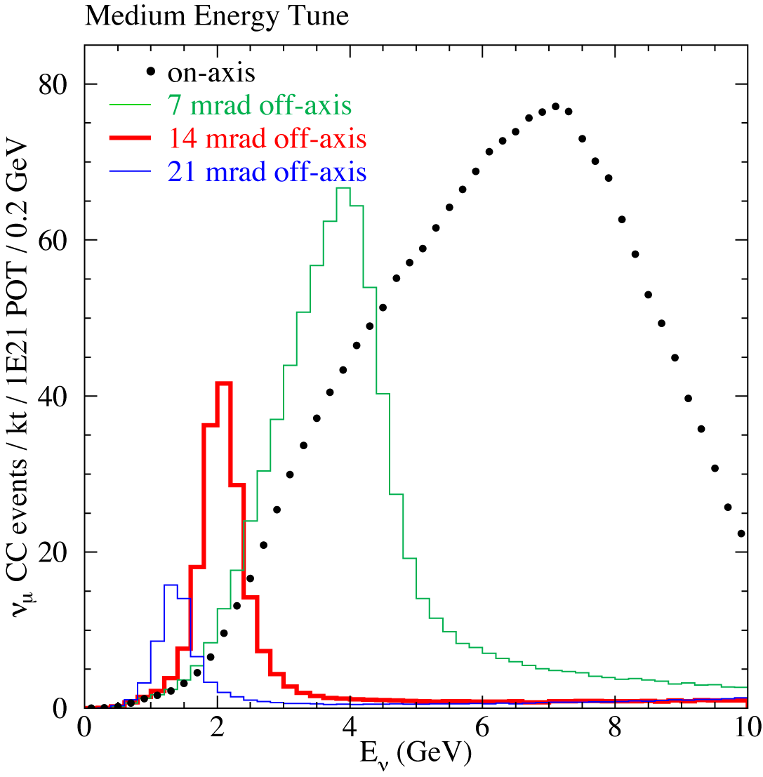
Current ν Program: NuMI➔MINOS+NOνA
The “Neutrinos from the Main Injector” (NuMI) line uses 120 GeV neutrinos from the Main Injector to produce neutrinos, which are detected in
MINOS: 725 km away in the Soudan Mine in Minnesota
NOνA: 810 km away in Ash River, Minnesota, 14.6 mrad off axis
Produces narrower energy spread

Slide 8
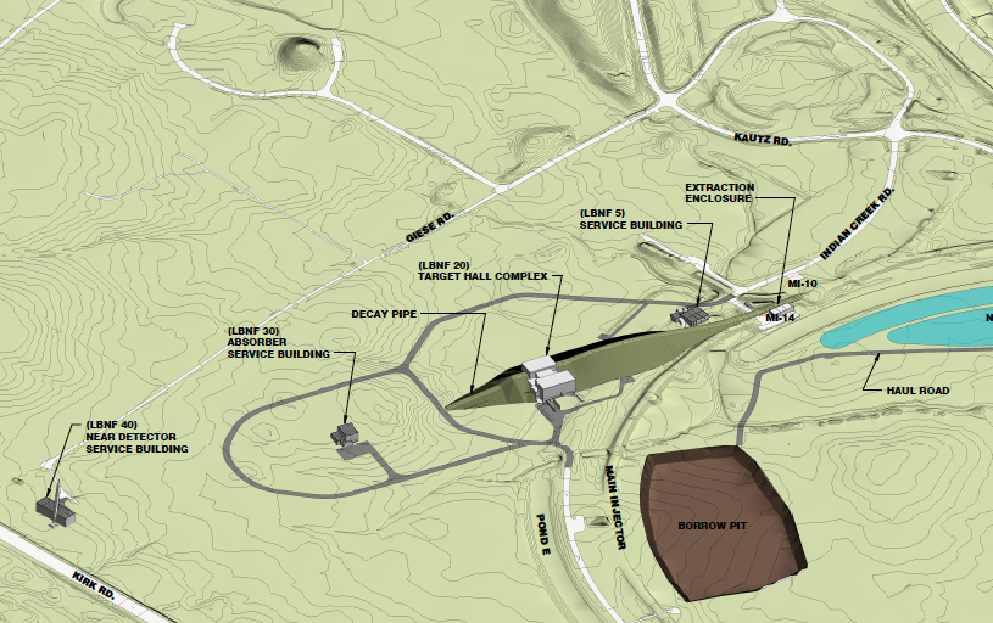
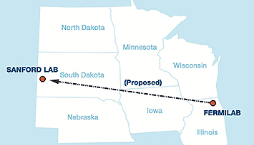
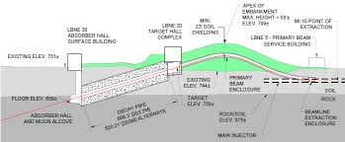
Future ν Program: LBNF➔DUNE
Fermilab will construct a new new “Long Baseline Neutrino Facility” (LBNF) beam line to produce neutrinos for the “Deep Underground Neutrino Experiment” (DUNE), located at the “Sanford Underground Research Facility” (SURF) in Lead, SD, 1300 km away.
Physics program requires ~900 kt•MW•yr
>50 years with current (400 kW) beam and 40 kt detector
As series of “Proton Improvement Plans” (PIPs) are being pursued to shorten this time.

Slide 9
Critical Issue: Space Charge Limit
Injected intensity is limited by the space charge tune-shift, which can drive harmonic instabilities.
So the maximum injected charge grows rapidly with increasing energy
total protons
“Bunch factor” = I_{peak}/I_{ave}
(Reduce with higher RF harmonics)
= 3 for 95% Gaussian emittance
1 for 100% uniform (painted) emittance
normalized emittance
doesn’t include improvement of going to uniform distribution with painting

Slide 10
Staged Plan to Increase Intensity
PIP (ongoing)
Numerous improvements to maximize potential of existing complex.
Provide 700 kW to NuMI + 30 kW to 8 GeV program
PIP-II (hope to get CD-0 soon)
Keep existing Booster, but increase cycle rate from 15 to 20 Hz
Replace existing 400 MeV linac with 800 MeV superconducting linac that has CW capability
Deliver 1.2 MW to NuMI or LBNF
Support 8 GeV program and 800 MeV program
(eg. 100kW 800 MeV beam to Mu2e-II)
PIP-III (conceptual)
Keep PIP-II linac
Replace Booster with “something”
Deliver 2.5 MW to LBNF + ??
Rapid Cycling Synchrotron (RCS) or pulsed linac?

Slide 11
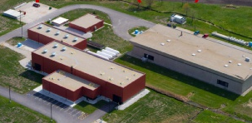
PIP-II R&D
The PIP-II Injector Experiment (PXIE)* is designed to test the technology needed for the PIP-II Linac
Among other things, PXIE will investigate
Low Energy Beam Transport (LEBT) pre-chopping.
Validation of chopper performance
Bunch extinction
Operation of Half Wave Resonator (HWR) in close proximity to 10 kW absorber
Emittance preservation
What I’ll be talking about
FAST/IOTA
PXIE
*Pay no attention to the X

Slide 12
Beyond PIP-II: Linac vs. RCS
The linac option would provide more beam at 8 GeV or lower energies, which could support a very diverse physics program, however
Unless there is a major breakthrough in SRF technology, it would cost significantly more than the RCS option.
The strong feedback from the DOE is that we should pursue the most cost effective way to deliver high power beam to LBNF/DUNE, with no specific mandate for a lower energy program. Therefore…
We are pursuing the RCS as the primary option, with the linac as backup
There might be a breakthrough in SRF technology
Priorities have been known to change

Slide 13
PIP-III Straw Man Parameters*
~6x record Booster ppp
~4x record Main Injector ppp
*P. Derwent

Slide 14
Mitigating Space Charge in the RCS
Recall:
Other ways?
This is where FAST comes in!
Can paint beam to increase emittance, but limited by Main Injector aperture (~20-25 π-mm-mr)
Can increase injection energy (costly)

Slide 15
RCS Comparisons
2.5 MW @ 60 GeV
Too big for “ordinary” synchrotron. Can FAST help?
We’d rather not build the expensive linac extension if we don’t have to

Slide 16
Novel Ways to Mitigate Space Charge
Non-linear integrable optics
All synchrotrons ever built are based on linear optics (magnetic quadrupoles). Non-linearities are handled perturbatively, and eventually lead to instabilities.
Is has been shown* that non-linear magnetic fields that satisfy a very particular set of conditions can result in stable orbits, but without a unique tune
Extremely insensitive to harmonic instabilities
Stable up to space charge tune shifts of order unity!
Electron lens
A beam of electrons can be used to cancel the space charge effects of the protons
Demonstrated in the Tevatron
Used operationally at RHIC
*Danilov, Nagaitsev, PRSTAB 2010

Slide 17
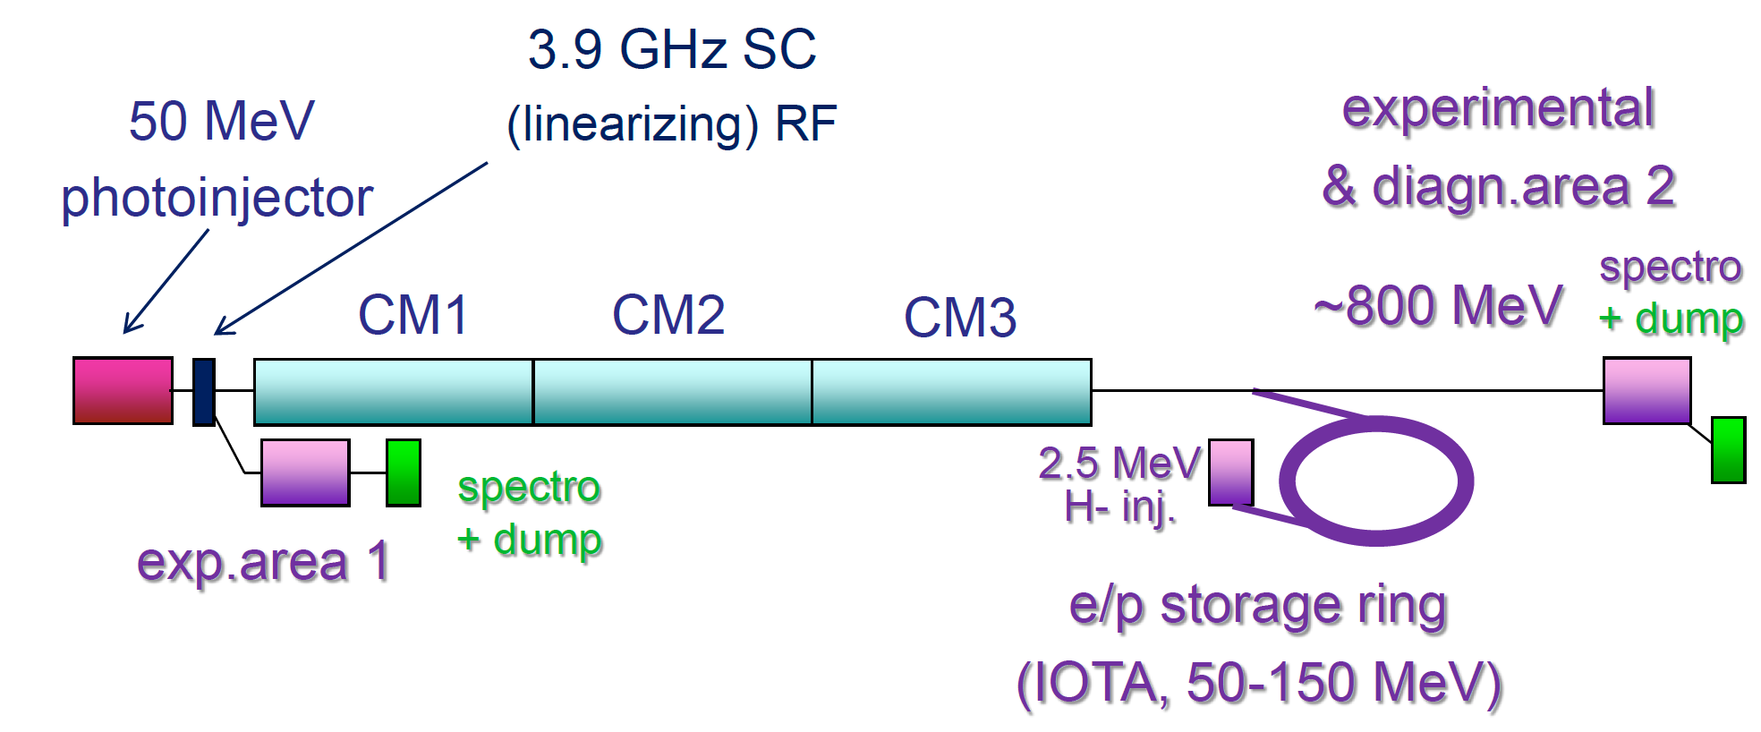
ASTA/IOTA: Original Proposal
This facility began life as the “Advanced Superconducting Test Accelerator (ASTA)”, designed as a test bed for ILC technology
Front end + 3 cryomodules = ~800 MeV electron
Designed an electron-based experimental program around this facility
Tacked on the “Integrable Optics Test Accelerator (IOTA)” to test non-linear integrable optics.

Slide 18
Existing Infrastructure
IOTA capitalizes on the investments made by OHEP for highly successful ILC/SRF R&D Program.
Construction of ASTA (formerly NML) began in 2006 as part of the ILC/SRF R&D Program and later American Recovery and Reinvestment Act (ARRA). The facility was motivated by the goal of building, testing and operating a complete ILC RF unit.
Multi-million (>$90M) investment resulted in the successful commissioning of 1.3 GHz SRF cryomodule (CM2).
Beam through low-energy photo injector
Facility nears completion
The addition of IOTA expands scope to host high-intensity accelerator research.

Slide 19
Changing Priorities
A review of several programs (ASTA, ATF-II, and FACET-II) was held in 2013, and the key findings were:
The validation of an electron injector and single cryomodule was a worthy effort, but
No strong case for additional cryomodules
Much of the electron-based R&D program could be done at other facilities
The IOTA ring is an interesting and unique facility, and should be considered the driving priority
New plan:
Emphasis would be in IOTA program
ASTA will serve primarily as an injector for IOTA, but will also validate the technology and support a significant, but reduced experimental program of its own.

Slide 20
New Plan, New Name
Because the emphasis of the facility has changed, so has had the name: ASTA/IOTA➔Fermilab Accelerator Science and Technology (FAST) Facility
Reduce cryomodules from three to one
Primary mission is as an injector for IOTA

Slide 21
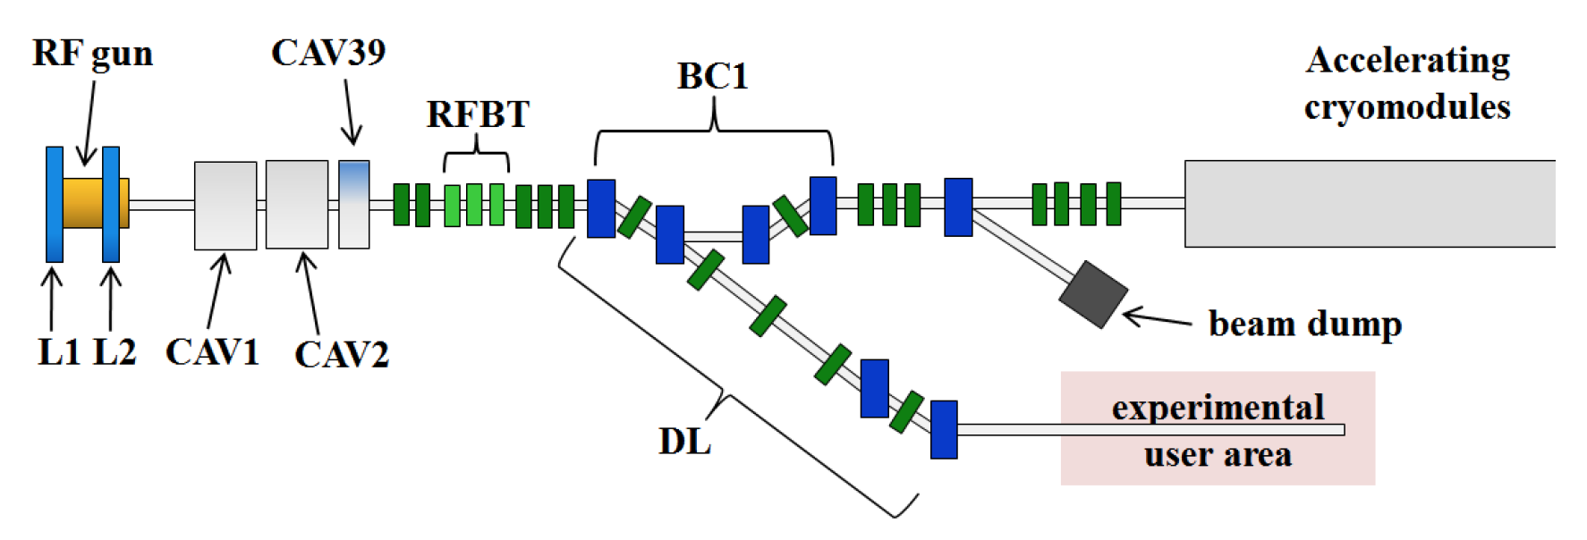
e⁻ Injector
Parameter | ILC nominal | Range
Bunch charge | 3.2 nC | 10pC to > 20 nC
Bunch spacing | 333 ns | <10 ns to 10 s
Bunch train | 1 ms | 1 bunch to 1 ms
Train rep. rate | 5 Hz | 0.1 Hz to 5 Hz
Transverse emit. | 25 mm-mrad | 1 to 100 mm-mrad
r.m.s. bunch length | 1 ps | 10fs to 10ps
Beam energy | 300 MeV | 50-300 MeV

Slide 22
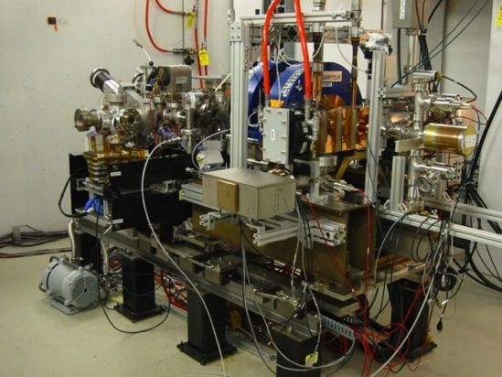
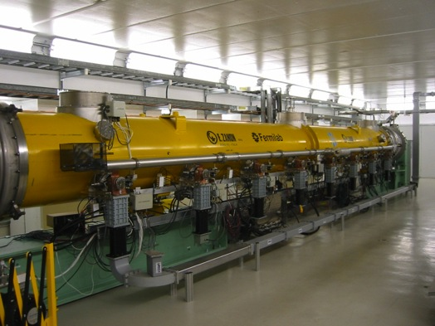
ASTA
Progress
Electron source and cryomodule are in place
First 50 MeV electron beam

Slide 23
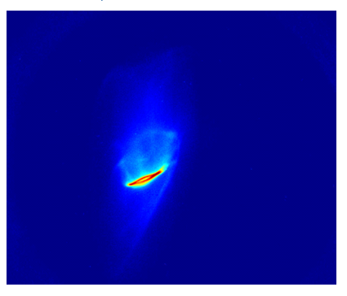
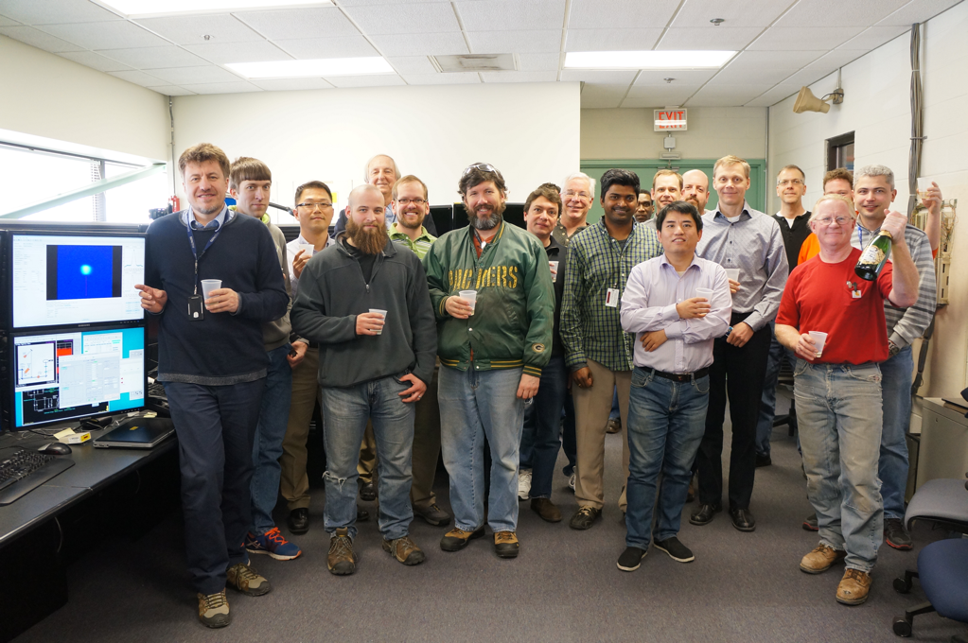
First Electrons Through Photoinjector!
Sign-offs Wednesday, 25 March, 2015
Electrons beyond the gun - Wednesday, 25 March
Beam after CC2, towards end of line – Thursday, 26 March
Electrons seen at low energy beam absorber ( ~20 MeV) – Friday morning, 27 March

Slide 24
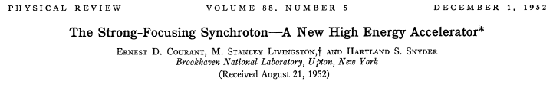
On to IOTA…
All accelerators today are based on physics worked out in the 1950s
Stable orbits based on “linear” optics
The defining magnetic lattice contains only dipole and quadrupole terms.
The result is a system in which particles experience a transverse force which depends linearly on their deviation from a reference orbit. Described in general by a “Hill’s Equation”

Slide 25
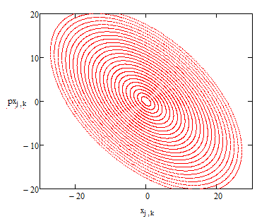
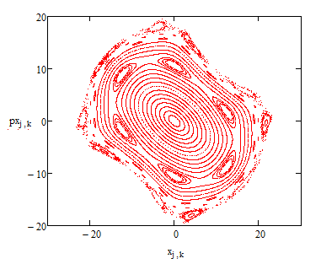
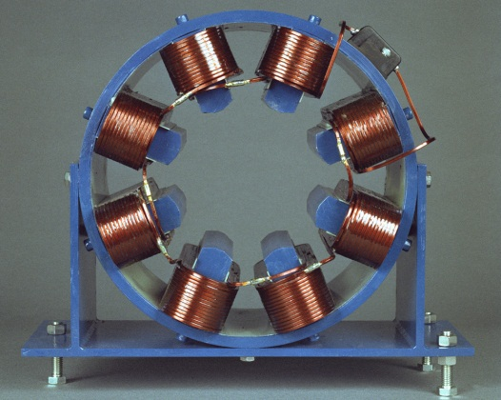
Motion in a Linear System
Properties of linear lattices
Explicit solution
In the paraxial approximation (sinθ~tanθ~θ), particles undergo a fixed number of oscillations per orbit (“tune”) which is independent of amplitude.
Nonlinear terms are dealt with perturbatively, and generally lead to chaotic instability at high amplitudes
octupole

Slide 26
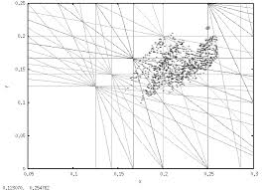
Instabilities In Linear Systems
A unique tune leads to inherent instabilities
Tune spread➔”Landau Damping”
Lattice imperfections lead to harmonic instabilities
In particular, space charge can shift the tune onto an instability
Space charge limit

Slide 27
Do Accelerators Need to be Linear?
Motion will be stable if we can identify conserved integrals of motion➔”Integrable”
There has been a long search for integrable nonlinear systems.
Early work
Orlov (1963)
McMillan (1967) – 1D solution
Perevedentsev, Danilov (1990) – generalization of McMillan case to 2D, round colliding beams. Require non-Laplacian potentials to realize

Slide 28
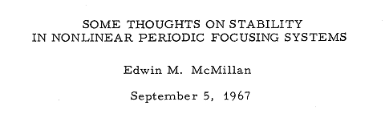
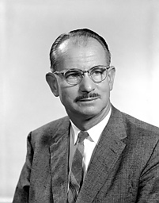
2D Generalization of McMillan Mapping
1D – thin lens kick
2D – a thin lens solution can be carried over to 2D case in axially symmetric system (non-Laplacian!)
1. The ring with transfer matrix
2. Axially-symmetric thin kick

Slide 29
2D Generalization of McMillan Mapping
The system is integrable. Two integrals of motion (transverse):
Angular momentum:
McMillan-type integral, quadratic in momentum
For large amplitudes, the fractional tune is 0.25
For small amplitude, the electron (defocusing) lens can give a tune shift of ~ –0.3 per cell !
Potentially, can cross an integer resonance

Slide 30
Verification: VEPP-2000
Danilov and Perevedentsev’s “round colliding beams”
equal beta functions, tunes, and emittances
no coupling
Under these conditions
longitudinal component of angular momentum is conserved
dynamics is “quasi integrable”
This was demonstrated experimentally at the BINP VEPP-2000 e+ e- collider, which achieved record tune spread of 0.25 (Romanov, NA-PAC13)
Solution would be fully integrable if beams had “McMillan distribution”
Can also be achieved with electron lenses!

Slide 31
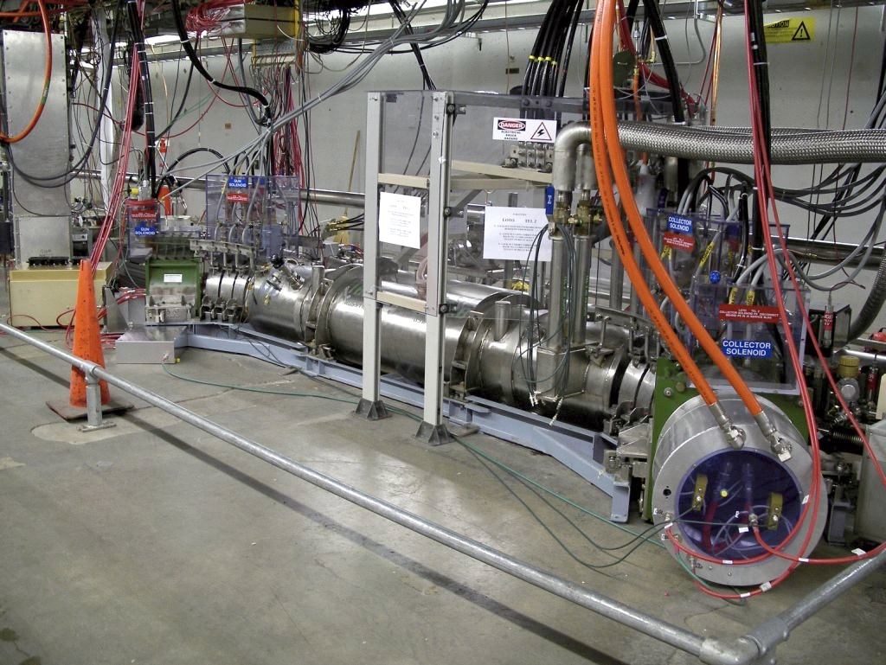
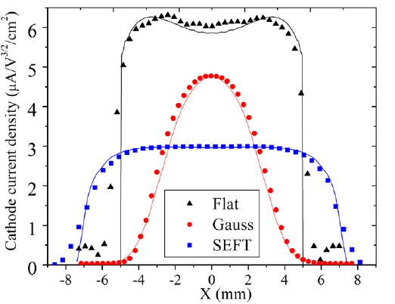
We can test this: IOTA Electron Lens
Capitalize on the Tevatron experience and recent LARP work
Re-use Tevatron EL components
Arbitrary current profile

Slide 32
Laplacian Solution*
Start with a Hamiltonian
Choose s-dependence of the nonlinear potential such that H is time-independent in normalized variables
This results in H being the integral of motion
Note: there is no requirement on V – can be made with any conventional magnets, i.e. octupoles
*Danilov and Nagaitsev, Phys. Rev. ST Accel. Beams 13, 084002 (2010) (2010)

Slide 33
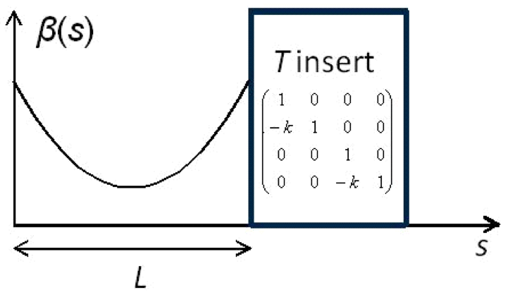
Nonlinear Integrable Optics with Laplacian Potential*
Start with a round axially-symmetric linear lattice (FOFO) with the element of periodicity consisting of
Drift L
Axially-symmetric
focusing block “T-insert”
with phase advance n×π
Add special nonlinear potential V(x,y,s) in the drift such that
can be also

Slide 34
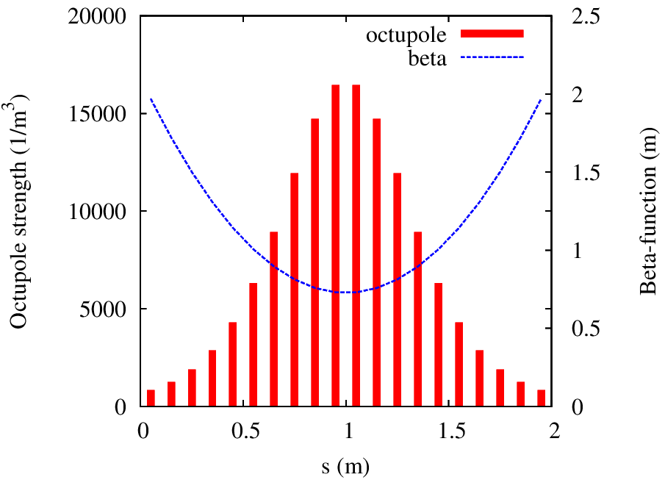
Quasi-Integrable System
Build V with Octupoles
Only one integral of motion – H
Tune spread limited to ~12% of Q₀

Slide 35
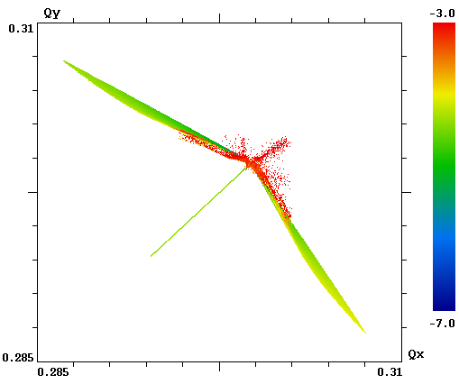
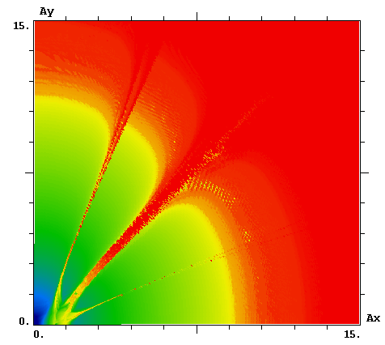
Quasi-Integrable System with Octupoles
While dynamic aperture is limited, the attainable tune spread is large
Q_{y}
A_{y}
A_{x}
Q_{x}

Slide 36
Special Potential – Second Integral of Motion
Find potentials that result in the Hamiltonian having a second integral of motion quadratic in momentum
All such potentials are separable in some variables (cartesian, polar, elliptic, parabolic)
First comprehensive study by Gaston Darboux (1901)
Darboux equation
General solution in elliptic variables ξ, η , with f and g arbitrary
Solution that satisfies the Laplace equation

Slide 37
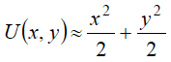
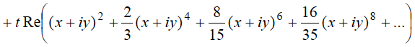
Maximum Tune Shift
Multipole expansion of U:
For small-amplitude motion to be
stable*, t<0.5
Theoretical maximum nonlinear tune shift per cell is
0.5 for mode 1, or 50% per cell
0.25 for mode 2, or 25% per cell
-c
x
c

Slide 38
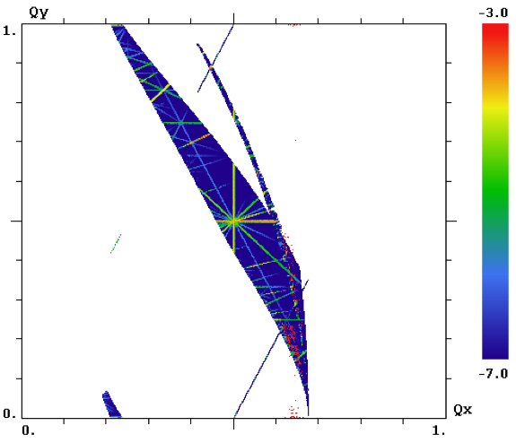
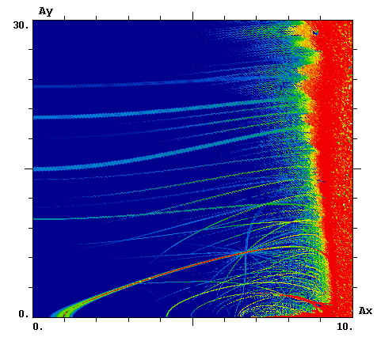
Single Particle Dynamics in Integrable Optics
Q_{y}
A_{y}
Q_{x}
A_{x}
Integer resonance Q_{y} = m

Slide 39
Stability of Nonlinear Lattices
Nonlinear systems can be more stable!
1D systems: non-linear (unharmonic) oscillations can remain stable under the influence of periodic external force perturbation. Example:
2D: The resonant conditions
are valid only for certain amplitudes.
Nekhoroshev’s condition guaranties detuning from resonance and, thus, stability.
An Exponential Estimate of the Time of Stability of Nearly-Integrable Hamiltonian Systems. Russian Math. Surveys 32:6 (1977) from Uspekhi Mat. Nauk 32:6 (1977)
Notes:
change ref.

Slide 40
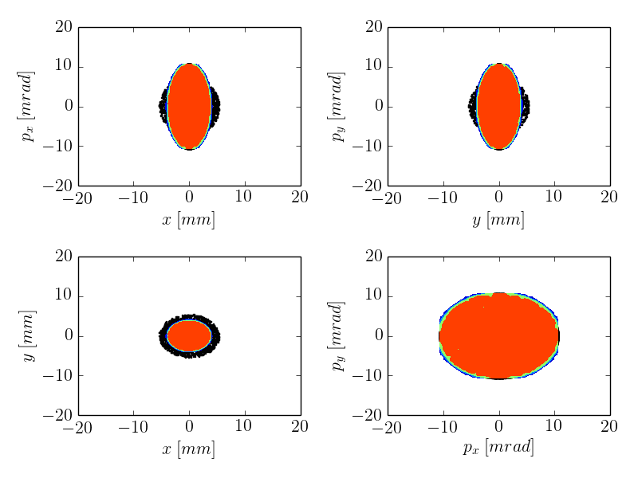
Space Charge in Linear Optics
System: linear FOFO 100 A linear KV w/mismatch
Result: quickly drives test-particles into the halo
ΔQ_{sc} ~ –0.7
Tech-X, RadiaSoft simulation

Slide 41
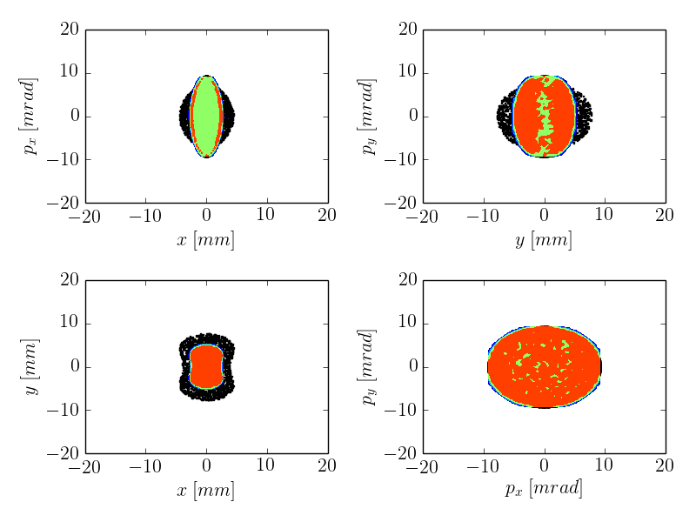
Space Charge in NL Integrable Optics
System: linear FOFO 100 A linear KV w/mismatch
Result: nonlinear decoherence suppresses halo
ΔQ_{sc} ~ –0.7
Tech-X, RadiaSoft simulation

Slide 42
Validating Nonlinear Optics
Both electron lenses and nonlinear magnetic elements involve discrete insertions in an otherwise conventional lattice.
Albeit a lattice with strict control over lattice functions!
This allows for the design of a fairly simple “test bed” to evaluate the efficacy of these solutions.

Slide 43
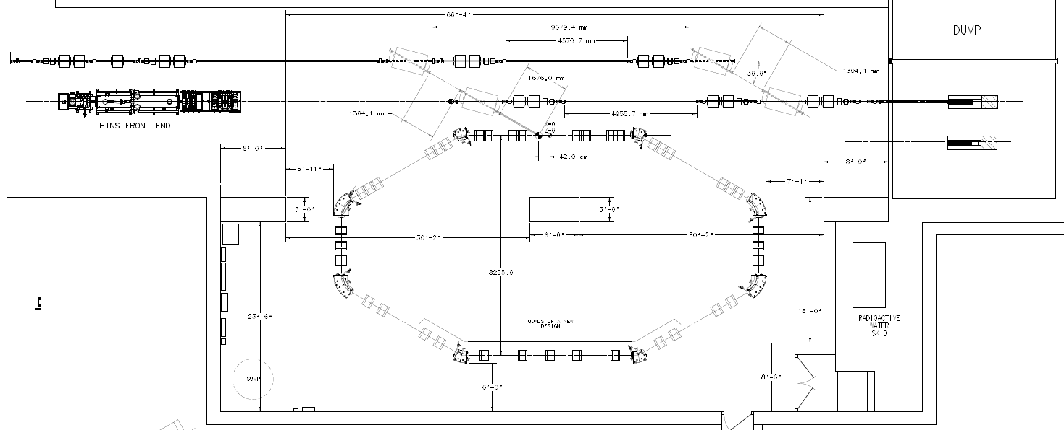
Integrable Optics Test Accelerator (IOTA)
e- beam line
p beam line
2.5 MeV RFQ

Slide 44
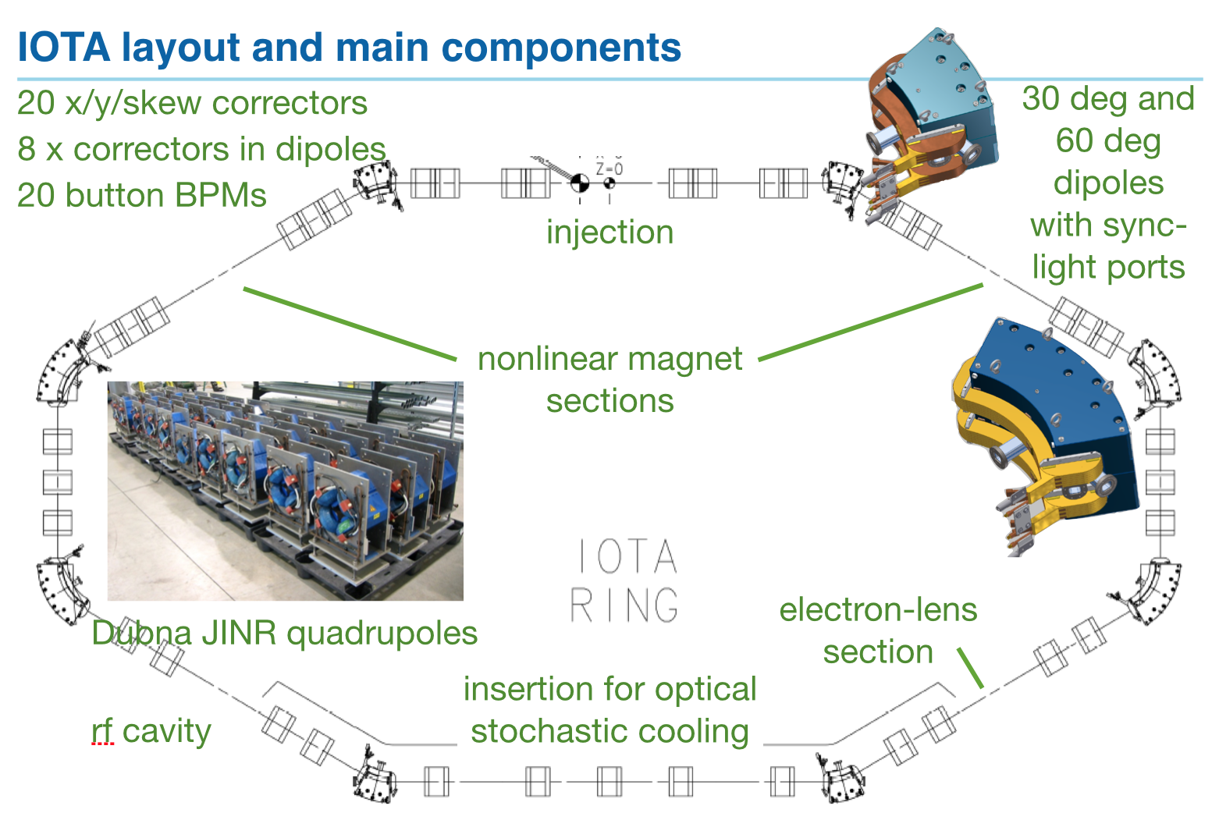
IOTA Layout

Slide 45
IOTA Parameters (Electrons)
Nominal kinetic energy | e⁻: 150 MeV
Nominal intensity | e⁻: 1×10⁹
Circumference | 40 m
Bending dipole field | 0.7 T
Beam pipe aperture | 50 mm dia.
Maximum b-function (x,y) | 12, 5 m
Momentum compaction | 0.02 - 0.1
Betatron tune (integer) | 3 - 5
Natural chromaticity | -5 - -10
Transverse emittance r.m.s. | 0.04 μm
SR damping time | 0.6s (5×10⁶ turns)
RF V,f,h | 1 kV, 30 MHz, 4
Synchrotron tune | 0.002 - 0.005
Bunch length, momentum spread | 12 cm, 1.4×10⁻⁴

Slide 46
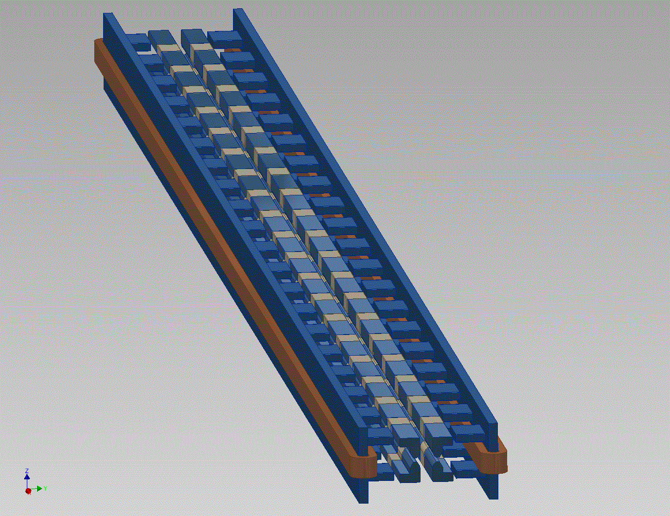
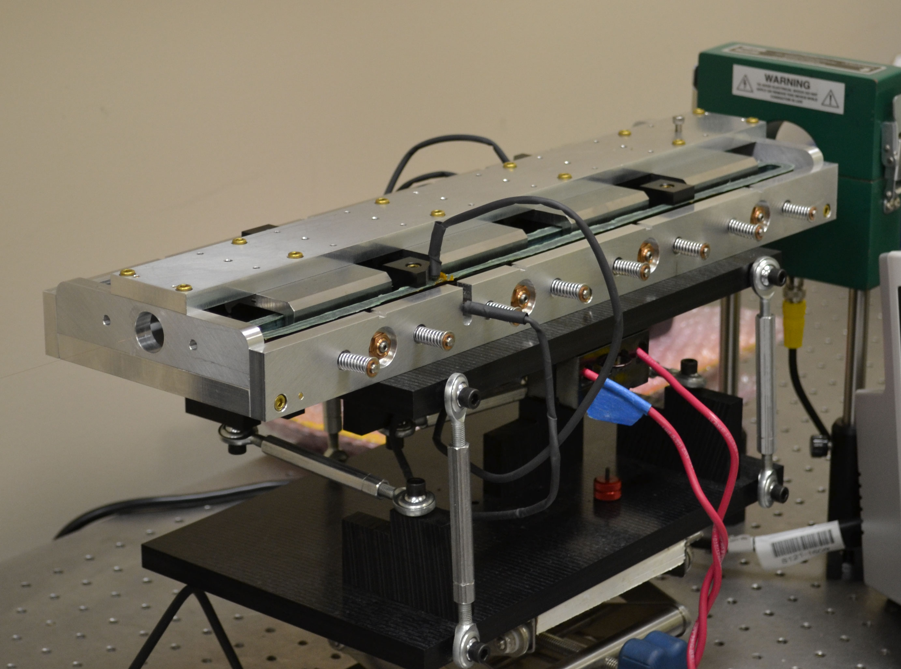
Nonlinear Magnet
Joint effort with RadiaBeam Technologies (Phase I and II SBIR)
FNAL Concept: 2-m long
nonlinear magnet
RadiaBeam short prototype. The full 2-m magnet will be designed, fabricated and delivered to IOTA in Phase II

Slide 47
IOTA Goals for Integrable Optics
The IOTA experiment has the goal to demonstrate the possibility to implement nonlinear integrable optics with a large betatron frequency spread ΔQ>1 and stable particle motion in a realistic accelerator design
Benefits of nonlinear integrable optics include
Increased Landau damping
Improved stability to perturbations
Resonance detuning

Slide 48
Integrable Optics Test Accelerator (IOTA)
Unique features:
Can operate with either electrons or protons (up to 150 MeV/c momentum)
Large aperture
Significant flexibility of the lattice
Precise control of the optics quality and stability
Set up for very high intensity operation (with protons)
Based on conventional technology (magnets, RF)
Cost-effective solution
Balance between low energy (low cost) and discovery potential

Slide 49
IOTA Staging – Phase I
Phase I will concentrate on the academic aspect of single-particle motion stability using e- beams
Achieve large nonlinear tune shift/spread without degradation of dynamic aperture by “painting” the accelerator aperture with a “pencil” beam
Suppress strong lattice resonances = cross the integer resonance by part of the beam without intensity loss
Investigate stability of nonlinear systems to perturbations, develop practical designs of nonlinear magnets
The measure of success will be the achievement of high nonlinear tune shift = 0.25
Notes:
color pencil beam

Slide 50
IOTA Staging – Phase I
The magnet quality, optics stability, instrumentation system and optics measurement techniques must be of highest standards in order to meet the requirements for integrable optics
1% or better measurement and control of β-function, and 0.001 or better control of betatron phase
This is why Phase I needs pencil e⁻ beams as such optics parameters are not immediately reachable in a small ring operating with protons

Slide 51
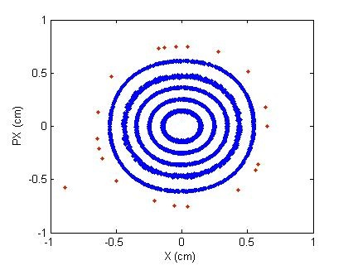
Experimental Procedure
Two kickers, horizontal and vertical, place particles at arbitrary points in phase space
Measure beam position on every
turn to create a Poincare map
As electrons lose energy due to synchrotron radiation, they will cover all available phase space
Can control the strength on the nonlinearity
Final goal – measure dependence of betatron frequency on amplitude

Slide 52
Phase II: Proton Injection
Luckily, we have an extra RFQ just lying around…
The HINS (“High Intensity Neutrino Source”) was developed as the front end of a pulsed “Project X” 8 GeV proton linac
Because of cooling problems, it never reached its design pulse rate
ProjectX (now PIP-II) specification was changed to a CW front end
HINS->PXIE
HINS RFQ available for our use

Slide 53
IOTA Proton Injector Parameters
slower than UMER electrons

Slide 54
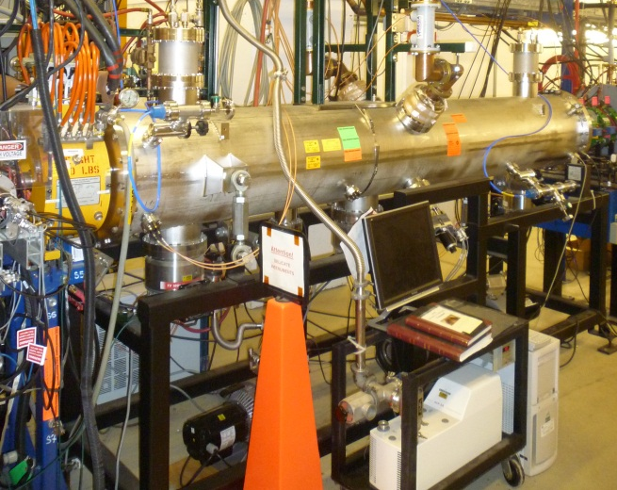
Phase II (cont’d)
After the IOTA commissioning, we will move the existing 2.5 MeV proton/H- RFQ into the FAST hall to inject protons into the IOTA ring.
Allows tests of Integrable Optics with protons and realistic space charge beam dynamics studies
Allows space charge compensation experiments
Unique capability
ΔQ_{SC} =0.5 for one-turn injection
*multi-turn injection possible
2.5 MeV RFQ
Notes:
multi-tun injection possible

Slide 55
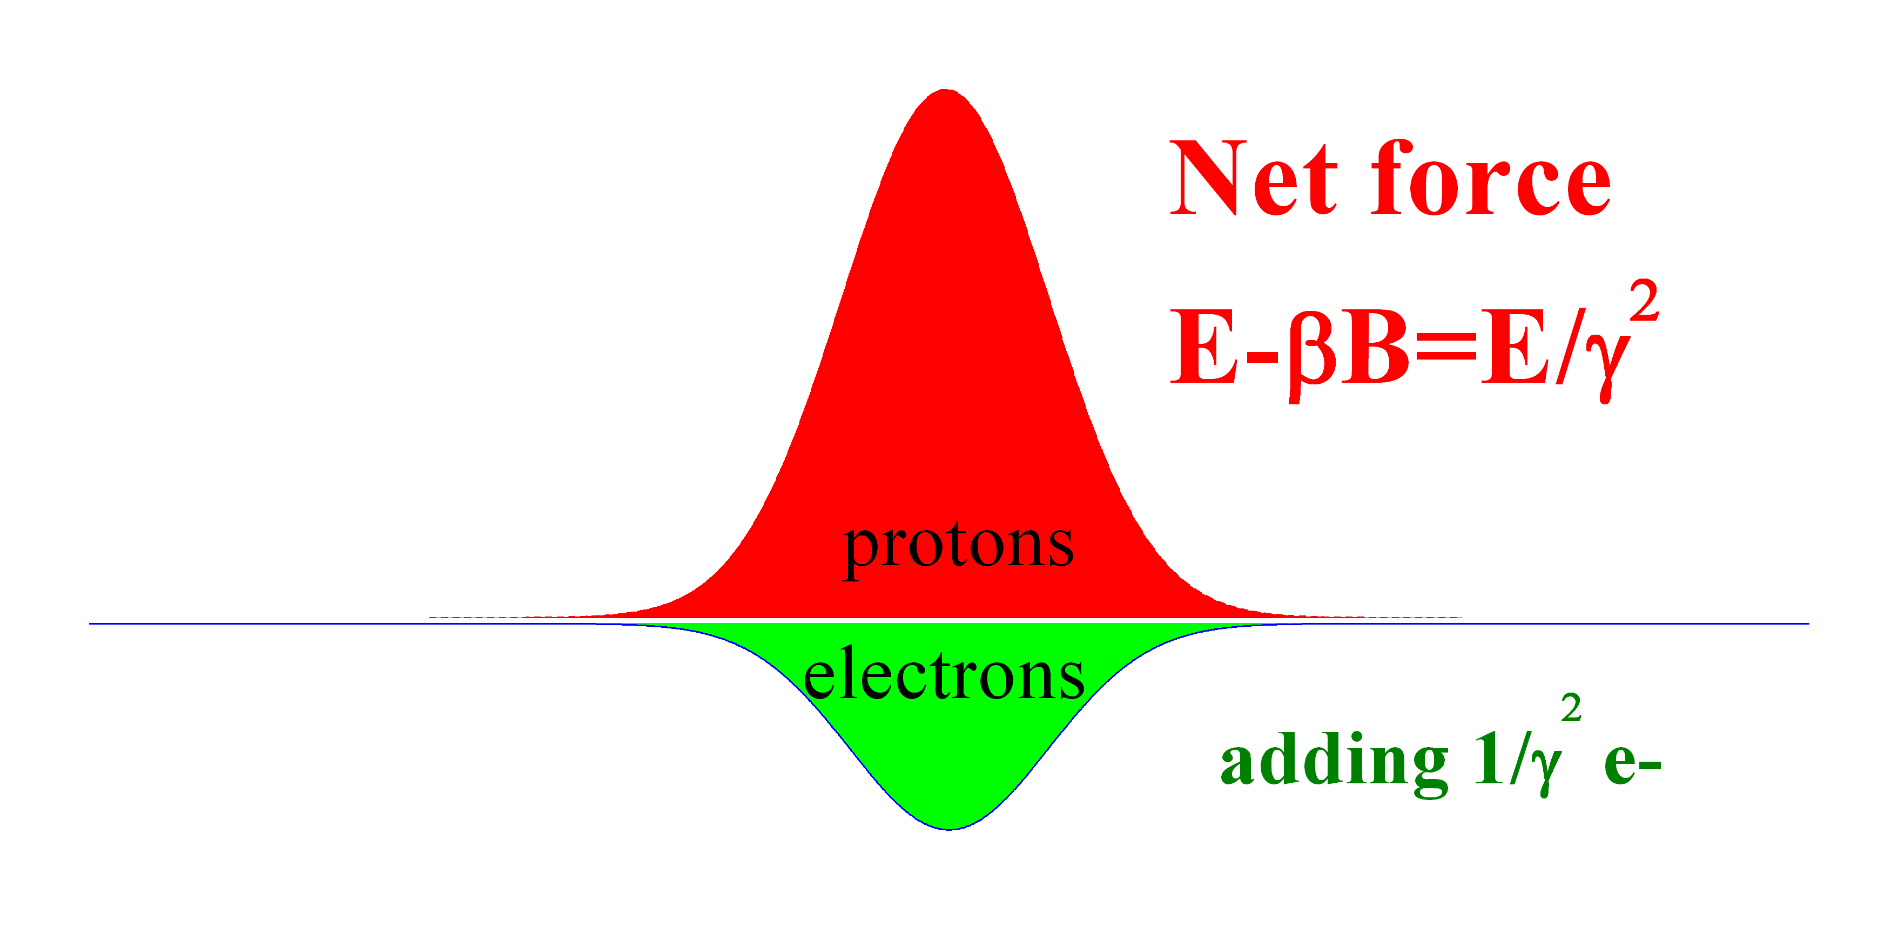
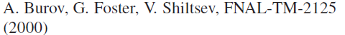
Space Charge Compensation
B=βE
r, across the beam

Slide 56
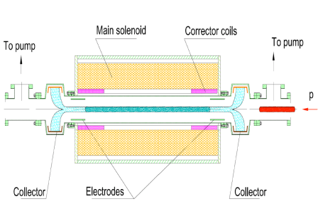
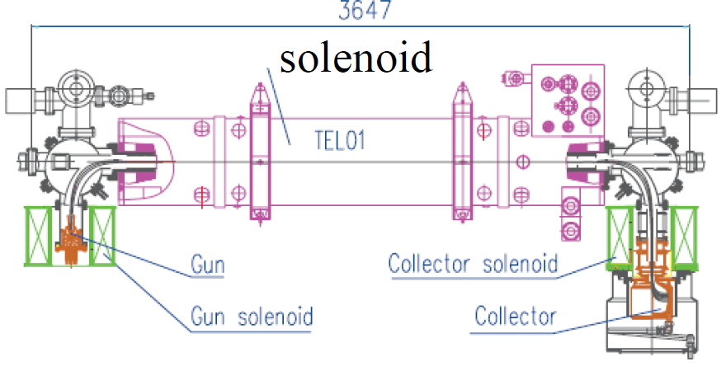
Possible Implementations
E-column concept
E-lens concept
1. The impact of electrons is equal to the total impact of space-charge over the ring
2. The transverse profile of the electron is made the same as that of the proton beam
→ use of solenoid
3. The system of magnetized electrons and protons is now dynamically stable

Slide 57
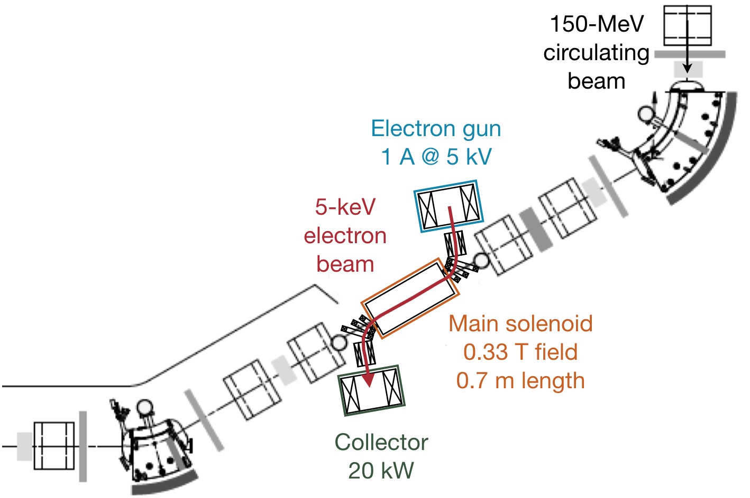
IOTA Electron Lens
Capitalize on the Tevatron experience and recent LARP work
Re-use Tevatron EL components

Slide 58
Plan of Activities and Status
Phase 1: FY15-17
Construction of main elements of the FAST/IOTA facility:
electron injector based on existing FAST electron linac
Low energy injector operational. HE beamline construction in FY15. Connect CM2 and send beam down HE beamline in FY16
IOTA ring
Most components procured. Begin assembly in FY16
proton injector based on existing HINS proton source in situ
Resurrecting the ion source in FY15, RFQ in FY16
special equipment for AARD experiments.
Commissioning of the IOTA ring with electron beam – FY17
Study of single-particle dynamics in integrable optics with electron beams.

Slide 59
Plan of Activities – Outlook
Phase 2: FY18-20
Commission IOTA operation with proton beams.
Carry out space-charge compensation experiments with nonlinear optics and electron lenses.
Phase 3: FY21 and beyond
Study the application of space-charge compensation techniques to next generation high intensity machines.
Expand the program beyond these high priority goals to allow Fermilab scientists and a broader accelerator HEP community to utilize unique proton and electron beam capabilities of the FAST/IOTA facility

Slide 60
Open Questions
Instrumentation:
Loss monitors:
Protons don’t get out of beam pipe!
Tentatively chosen diamond-based loss monitors in vacuum
Transverse proton development
Ionization Profile Monitor?
Gas jet?
Electron Deflection?
One of these plus retractable loss monitors for tails
Experimental program:
Fermilab has R&D has always been very “mission-oriented”
No real experience with a general purpose accelerator physics facility

Slide 61
Collaboration
A lot of interest to participate in IOTA from the accelerator community
2 annual Collaboration Meetings, ~60 participants
‘IOTA Focused Workshop’
Significant intellectual and in-kind contributions, expressions of interest
NIU, UMD, RadiaSoft, CERN, ORNL, BINP, Colorado State, Univ. Mexico – integrable optics, space charge effects, phase space manipulation
LBNL, ANL – optical stochastic cooling demonstration
UMD – multi-pickup beam profile monitor for IOTA
JINR – integrable optics and space charge, contributed quadrupole magnets for IOTA
Univ. Frankfurt – electron lens

Slide 62
International Space Charge Collaboration at IOTA
Collaborating institutions (at present): Fermilab, ORNL, CERN, RadiaSoft, UMD
Work on the scientific case, hardware development, simulations, planning and execution of space charge compensation experiments with protons in IOTA
Major topics
Operation of IOTA with protons, injection, and space charge measurements
Space charge compensation in nonlinear integrable lattice
Special magnets
Electron lens
Space charge compensation with electron columns
Space charge suppression with circular modes – for FCC

Slide 63
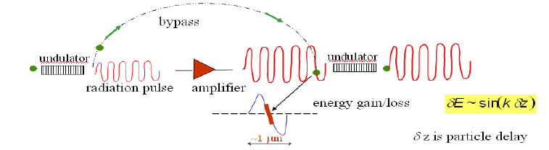
Optical Stochastic Cooling Demonstration
Goal:
Experimental demonstration of the optical stochastic cooling technique (1st – no optical amplifier, then with OPA)
Why IOTA:
Need IOTA – low energy (~100 MeV – minimal synchrotron radiation damping) flexible lattice e- storage ring
Motivation:
Beam cooling for high energy accelerators

Slide 64
Training and University Collaboration
Excellent connection to the university community through the Joint Fermilab/University PhD program
Already 9 graduate students doing thesis research at FAST/IOTA
7 NIU, 1 U.Chicago, 1 IIT, 2 more to join soon
Partnership with university groups
NIU – DOE GARD grant on OSC
Univ. of Maryland – NSF grant for IOTA-related work
Univ. Frankfurt – IOTA electron lens
Univ. Mexico – ASTA linac commissioning
Colorado State – ASTA gun stability
Interest from: UC Berkeley, MIT, Oxford

Slide 65
Summary
Experimental accelerator R&D at IOTA is one of the cornerstones of the proposed national R&D thrust “Multi-MW Beams and Targets”, and is well aligned with P5 priorities
IOTA offers a unique scientific program aiming at breakthrough research to allow for x3-5 increase of beam intensity in future proton rings
IOTA augments the US program lacking ring facilities for accelerator research and training
IOTA experiments are a great opportunity to explore something truly novel with circular accelerators
IOTA will be a strong driver of national and international collaboration and training

Slide 66
Acknowledgments
A.Burov, K.Carlson, A.Didenko, N.Eddy, V.Kashikhin, V.Lebedev, J.Leibfritz, M.McGee, S.Nagaitsev, L.Nobrega, H.Piekarz, E.Prebys, A.Romanov, G.Romanov, V.Shiltsev, R.Thurman-Keup, A.Valishev, S.Wesseln, D.Wolff (FNAL)
D.Shatilov (BINP)
G. Kafka (IIT)
S. Danilov (ORNL),
S. Antipov (U of Chicago)
J. Cary (Tech-X)
D. Bruhwiler, S. Webb (RadiaSoft)
F.O’Shea, A.Murokh (RadiaBeam)
R.Kishek, K.Ruisard (UMD)
JINR, Dubna

Slide 67
Backups

Slide 68
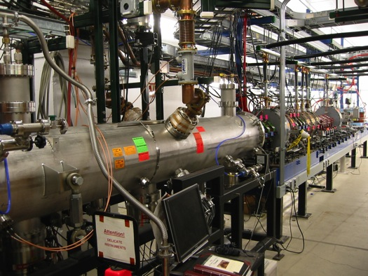
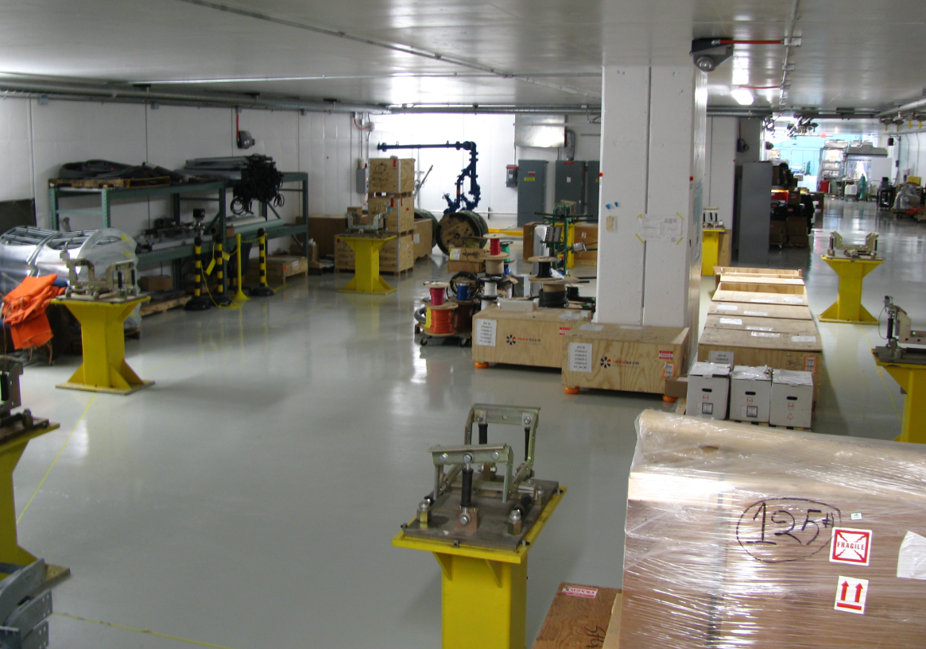
FAST
Need accelerator R&D beam facilities !

Slide 69
Space Charge in Linear Optics
ΔQ_{sc} ~ –0.7
System: linear FOFO 100 A linear KV w/mismatch
Result: quickly drives test-particles into the halo
Tech-X, RadiaSoft simulation

